Slide 1

ADVERTISING BASED ON USAGE

Slide 2
TEAM
SAI KALYAN AYYAGARI
MARIO VISHAL
SAI AMRUTH
RAJ KUMAR
KRISHNA TEJ

Slide 3
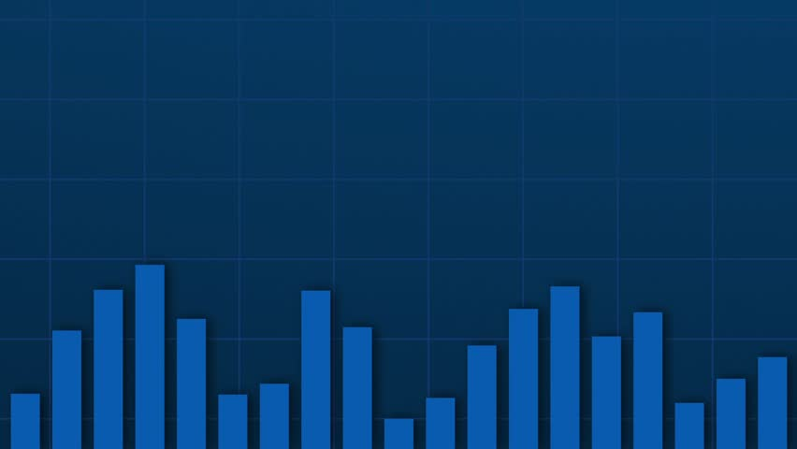
ABOUT THE PROJECT
The Project is based on Click-Through-Rate(CTR) prediction.
To analyse the Data set to obtain the independent variables which impact target feature.
And finally creating a Model from the algorithm which best suits it to predict the desired output.

Slide 4
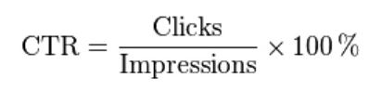
Click-Through-Rate(CTR)
Ratio of users who click on an ad to the number of total users who view the advertisement.
Used to measure the success of an online advertising campaign.
In a pay-per-click criteria, revenue can be maximised by choosing to display ads that have maximum CTR.

Slide 5
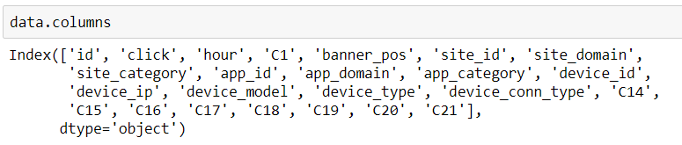
Technical Description
Data set has 24 features and 10k observations.
The output variable or the target variable is the feature “click”.
The data types of the features include int,float and object values.
The data type of “click” is int, and it has the output of either 0 or 1.

Slide 6
Our Dataset comprises of the following features:
id: ad identifier
click: 0 for non-click, 1 for click
hour: in the format of YYMMDDHH
C1: some anonymized categorical variable e.g. 1002
banner_pos: where a banner is located, 1 and 0
site_id: site identifier
site_domain: hashed site domain
site_category: hashed site category e.g. 28905ebd
app_id: mobile app identifier
app_domain
app_category
device_id: mobile device identifier
device_ip: IP address
device_model: hashed model e.g. iPhone 6, Samsung
device_type: hashed device type e.g. tablet, smartphone
device_conn_type: hashed type of connection e.g. Wi-Fi, 4G
C14-C21: some more anonymized categorical variables which have been kept private due to privacy concerns but have meaningful values and can have some impact on target variable

Slide 7
Libraries Used:
Numpy
Pandas
Scikit-learn
Matplotlib
Seaborn

Slide 8
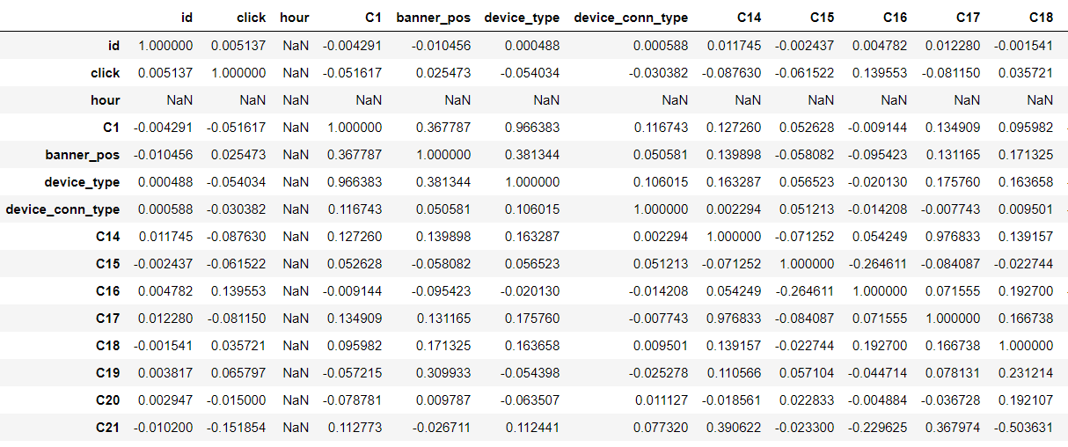
As the target variable is a categorical type of output we use classification method.
The mean of the feature “click” is 0.1706 it says that 17.6% of the ads were clicked.
Correlation table:
Table.1

Slide 9
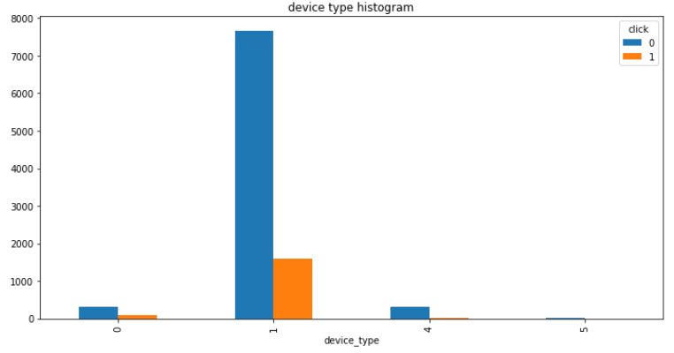
From the above Table.1 the highest positive correlation is between C1,banner_pos and device_type.
C16 and C21 are highly correlated to our target variable “click”.
So the potential input variables can be device_type, banner_pos, C1, C16 and C21.Which can impact our target variable.
Histogram of device_type:
From the histogram Fig.1
we observe that device
type of 1 as more clicks
and non clicks
clicked=1
non_clicked=0
Fig.1
Fig.1

Slide 10
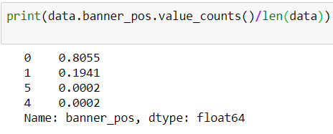
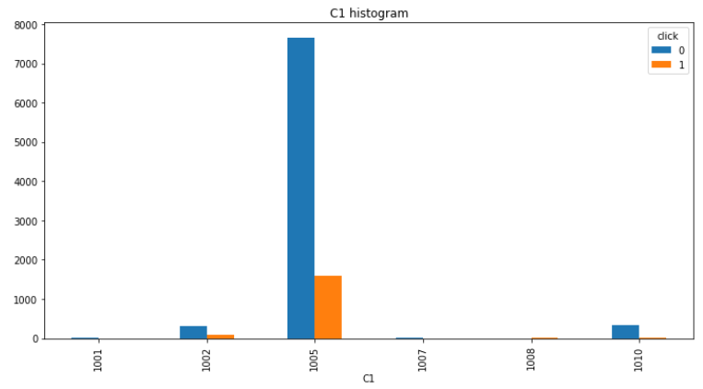
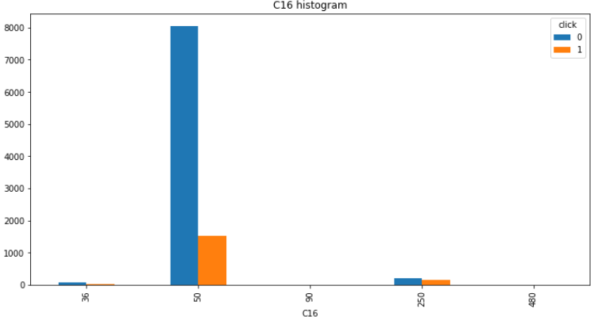
Banner position:
From the Fig.2 banner position of
0 is having 80.5% of clicks and non
clicks.
C1 Histogram C16 Histogram
Fig.2
Fig.3
Fig.4

Slide 11
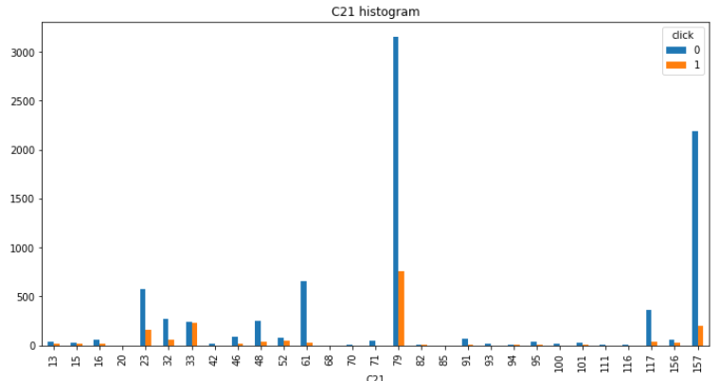
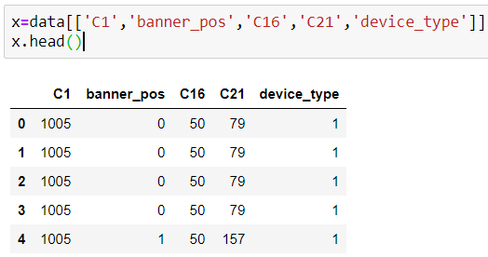
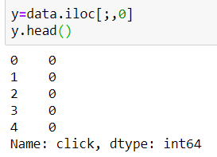
C21 Histogram
Separating the output target and the input variables
Fig.5

Slide 12
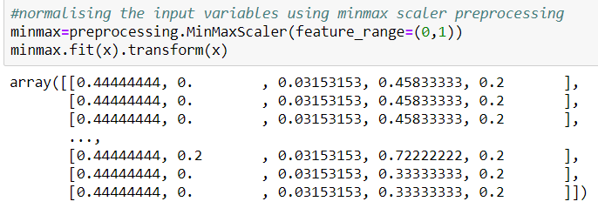
Normalization of input variables with MinMax scalar pre-processing.
Splitting the data into test and train set.In this data set we gave 80% data to training set and 20% for testing.
Applying algorithms on the model and choosing the best accurate method.

Slide 13
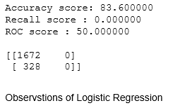
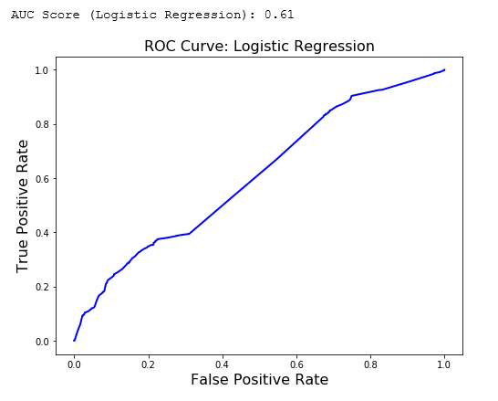
Logistic Regression:

Slide 14
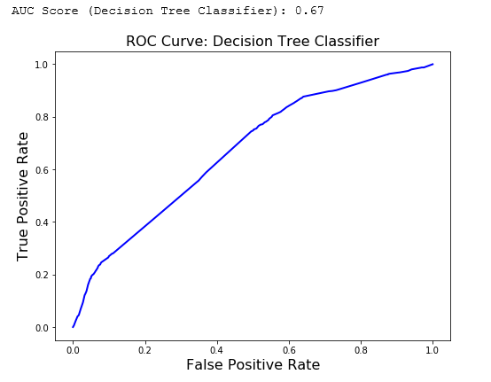
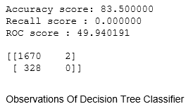
Decision Tree Classifier

Slide 15
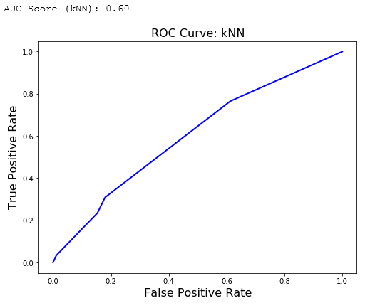
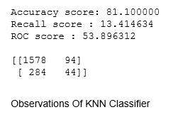
KNN Classifier:

Slide 16

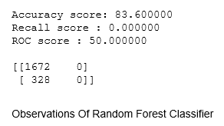
Random Forest Classifier:

Slide 17
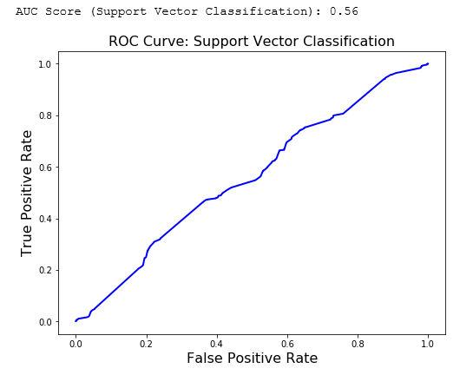
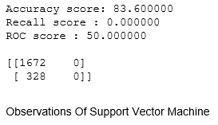
Support Vector Machine(SVM):

Slide 18
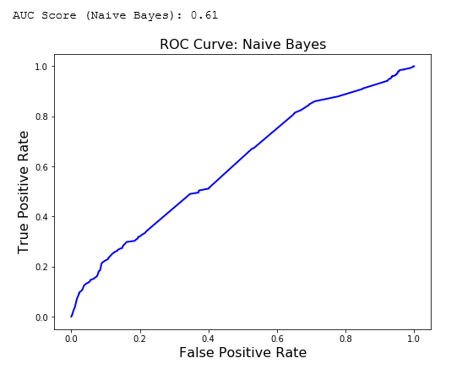
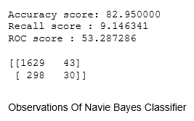
Naive Bayes Classifier:

Slide 19
Summary:
As from the previous slides the accuracy of Random Forest, Logistic Regression, Support Vector Machine(SVM) are equal i.e. 83.6%
And the ROC Scores are all equal i.e. 50.
So we considered Random Forest Classifier as the best suited algorithm for the model.

Slide 20
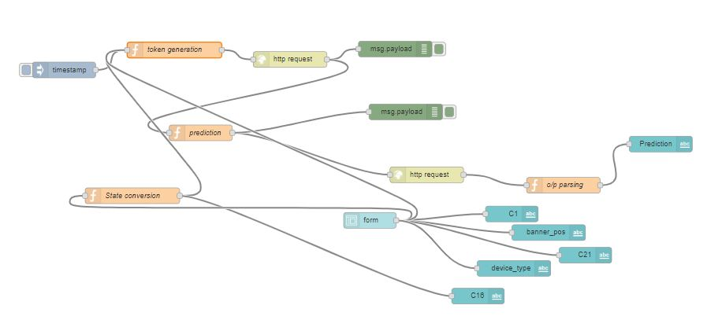
Node-Red Flow

Slide 21
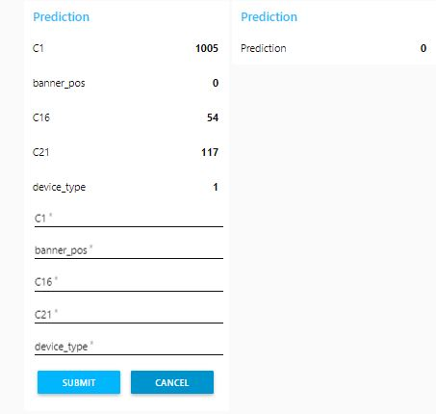
User Interface for Prediction

Slide 22
Bibliography
Data Set : www.Kaggle.com
Technical Description and Graphs : Jupyter Notebook Project File.

Slide 23
THANK YOU

